Slide 1
Formulas

Slide 2
Ooh…Coding! (Sort Of)
Excel has introduced you to a sort of proto-programming. When you write scripts, you will rely on functions (methods) that do something to or with arguments.
= | SUM( | 1, 2, 3 | )
 | Function | Arguments | Function

Slide 3
Ooh…Coding! (Sort Of)
When we reference a range or a set of ranges, Excel is given a set of variable inputs. Excel will determine the actual values of these inputs prior to executing the function.
= | AVG( | F4:F6 | )
 | Function | Variable Arguments | Function

Slide 4

Ooh…Coding! (Sort Of)
Q
What about this example?
Which is the function?
Which are the arguments?
= SUM( AVG(F4:F6), AVG(G4:G6) )

Slide 5

Ooh…Coding! (Sort Of)
Q
A
What about this example?
Which is the function?
Which are the arguments?
The AVG functions take the provided ranges as their arguments.
= SUM( AVG(F4:F6), AVG(G4:G6) )

Slide 6
Ooh…Coding! (Sort Of)
Q
A
What about this example?
Which is the function?
Which are the arguments?
This is a nested function. We’ll be doing plenty of complex nests in this class.
= SUM( AVG(F4:F6), AVG(G4:G6) )

Slide 7

You Can Code Too!
Here’s a Python snippet from the last class.
requests.get(target_url_italian, headers=headers).json() requests.get(target_url_mexican, headers=headers).json()

Slide 8
You Can Code Too!
Syntax and capabilities may differ across technologies and platforms, but fundamental concepts remain the same.
Function
Arguments
requests. requests. | get get | (target_url_italian, headers=headers) (target_url_mexican, headers=headers) | .json .json | () ()
Another Function
(Chained)

Slide 9
There are multiple ways to select data in a formula
Most of us learned to select a range of cells to input into a function
=AVG(A1:A10)

Slide 10
There are multiple ways to select data in a formula
But we can name a range of values to make interpreting formulas easier!
=AVG(A1:A10)
=AVG(prices)

Slide 11


Conditionals: If This, Then That
Conditionals present a way to control the flow of logic based on certain criteria being met. This is a core building block of all languages.
Step 2a
If criteria is met…
Step 1
If criteria is not met…
Step 2b

Slide 12

Conditionals: If This, Then That
=IF(D2>5,TRUE,FALSE)
If D2 > 5
Set Cell to True
Determine D2’s Value
If D2 <=5
Set Cell to False

Slide 13
But what if we want to combine conditions?

Slide 14
A
AND, NOT, OR

Slide 15
Ooh…Coding! (Sort Of)
Q
A
But what if we want to combine conditions?
AND, NOT, OR
=IF(AND(D2>5, D2<10),TRUE,FALSE)

Slide 16
Conditionals: If This, Then That
Nesting conditionals are powerful, but can become convoluted very quickly!
If D2 > 5 AND D2 < 10
Set Cell to True
Determine D2’s Value
If D2 <=5 OR D2 >= 10
Set Cell to False

Slide 17
What are “measures of central tendency”?

Slide 18
A
Values used to describe the center of a data set.

Slide 19
Central Tendency
Three most common measures of central tendency:
Mean
Median
Mode
The “arithmetic” average
To calculate: The sum of all values, divided by the number of values
The middle value of a data set
To calculate: Sort the data set and find the center
The most frequent value of a data set
To calculate: Count the frequency of each value in a data set, determine the most frequent value

Slide 20

Formatting in Excel falls into two categories
Data Formatting
Style Formatting
Changes the way a value is represented in a cell.
Used to help with interpretation or to add context to the range of values
Examples
Date and Time
Currency
Percentage
Scientific Notation
Changes the way the cell and text are viewed
Can include font color, cell highlighting, borders, etc.
Can be performed manually or using formulas/logic (conditional formatting)

Slide 21
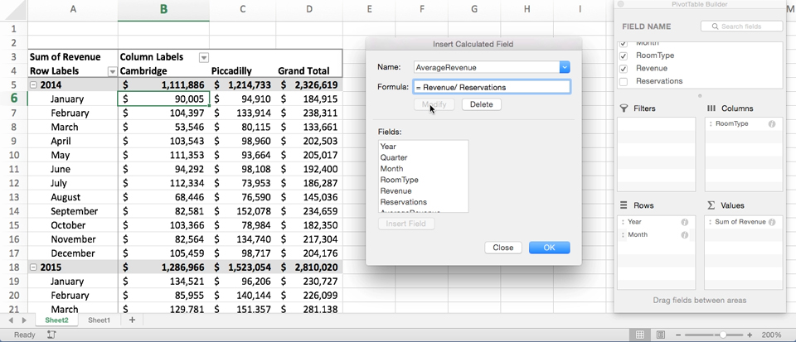
Get Pivot With It
Pivot tables are one of the most important data visualization concepts to master in this class. (Don’t worry. They are a cinch to deal with.)

Slide 22
Get Pivot With It
In essence, a pivot table is a summative analytic tool that allows us to perform aggregate functions that allow any combination of fields. (The term pivot table comes from the fact that we are pivoting along a data axis).
Seller | Qty. Sold | Date
Joseph | $42.50 | 1/1/17
Jacob | $65.00 | 1/3/17
Jacob | $5.25 | 1/6/17
Joseph | $125.00 | 1/6/17
Jacob | $3.50 | 1/7/17
Matt | $32.00 | 1/9/17
Seller | Total Sold
Joseph | $167.50
Jacob | $73.75
Matt | $32.00

Slide 23
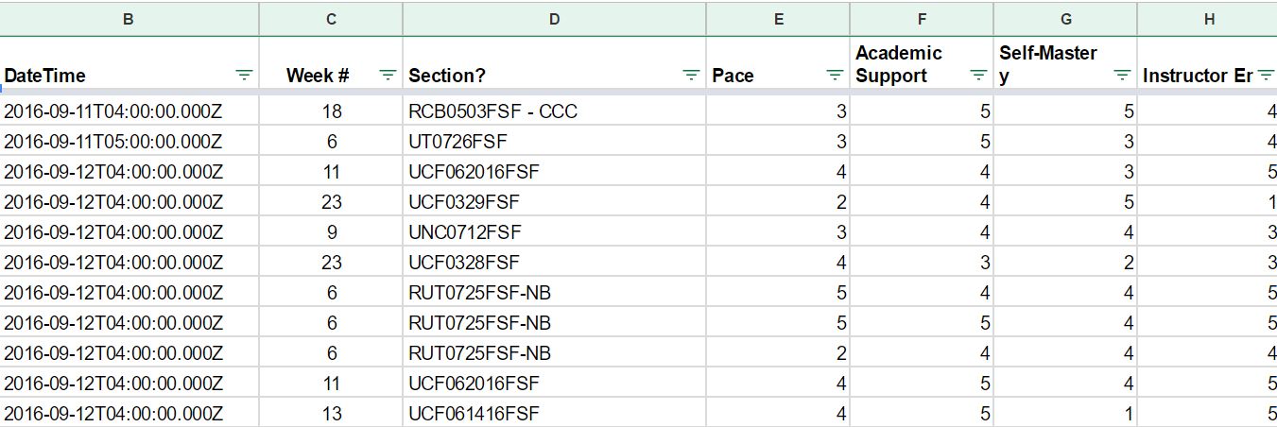
Word to the Wise: Keep It Flat!
Modern Business Intelligence (BI) tools like Tableau, Sisense, and Salesforce work best if data is stored in flat CSVs—meaning column headers represent fields (vertically) on the spreadsheet. This is largely because all of these technologies heavily utilize pivot tables as a tool for their visualizations. Don’t try to confuse this simplicity. “Spreadsheet magic” is a nightmare to analyze.

Slide 24
Look It Up with Lookups
Q
Assume this table is gigantic. How would we retrieve the population of a specific planet for use in another formula?
Planet | Population
Zeelo | 5020
Merinoa | 380
Cardboard Box | 2
… | …
Asteroid 9 | 95

Slide 25
Look It Up with Lookups
Q
Assume this table is gigantic. How would we retrieve the population of a specific planet for use in another formula?
A
=vlookup( <value>, <full table>,
<column to retrieve>,<match parameter>)
Planet | Population
Zeelo | 5020
Merinoa | 380
Cardboard Box | 2
… | …
Asteroid 9 | 95

Slide 26
Look It Up with Lookups
Q
What will this yield?
=vlookup( “Asteroid 9”, Planets, 3, FALSE)
Planet | Population | Species
Zeelo | 5020 | Zoltans
Merinoa | 380 | Murphies
Cardboard Box | 2 | Hambones
… | …
Asteroid 9 | 95 | Asterisks

Slide 27
Look It Up with Lookups
Q
What will this yield?
=vlookup( “Asteroid 9”, Planets, 3, FALSE)
Planet | Population | Species
Zeelo | 5020 | Zoltans
Merinoa | 380 | Murphies
Cardboard Box | 2 | Hambones
… | …
Asteroid 9 | 95 | Asterisks
A

Slide 28

Partner Activity: Product Pivot
Determine the "Product Price" of each row in the "Orders" sheet by using a VLOOKUP() that references each row's "Product ID"
The "Product Price" of a row does not include shipping
Determine the "Shipping Price" of each row in the "Orders" sheet by using a VLOOKUP() that references each row's "Shipping Priority"
Select all of the data on the "Orders" sheet and create a new pivot table that calculates the sum of both "Product Price" and "Shipping Price" for each "Order Number" and "Product ID"

